Slide 1

Programming in HMMM
Hacettepe University
Computer Engineering Department
BBM103 Introduction to Programming Lab 1
Week 2
Fall 2022

Slide 2
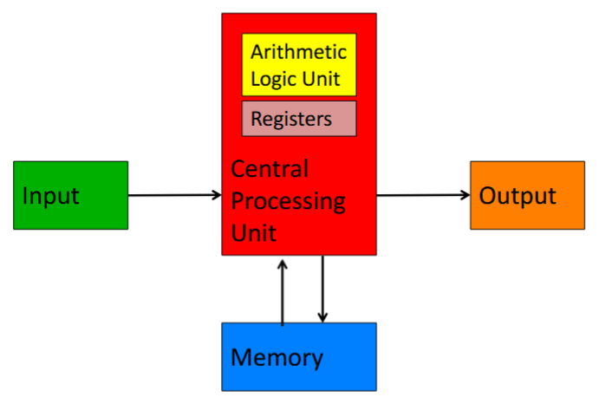
Von Neumann Architecture
A program (a list of instructions) is stored in the main memory.
Stored Program Concept
Instructions are copied (one at a time) into the instruction register in the CPU for execution.

Slide 3
Von Neumann Architecture
processing
program
CPU
Von Neumann bottleneck
RAM
central processing unit registers
random access memory locations
r1
0
0000 0001 0000 0001
1000 0010 0001 0001
0110 0010 0010 0001
0000 0010 0000 0010
0000 0000 0000 0000
General-purpose register, r1
1
r2
2
General-purpose register, r2
3
4
Programs are stored in memory in machine language.
5
(all bits)
6

Slide 4
Assembly Language
Assembly language is a human-readable machine language.
Instead of programming in binary (0’s and 1’s), it is easier to use an assembly language.
An assembler is a computer program that interprets software programs written in assembly language into machine language.
0
0000 0001 0000 0001
1000 0010 0001 0001
0110 0010 0010 0001
0000 0010 0000 0010
0000 0000 0000 0000
1
2
read r1
3
mul r2 r1 r1
4
add r2 r2 r1
5
write r2
6
halt
"mnemonics" instead of bits

Slide 5
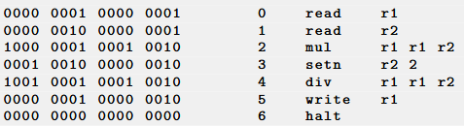
The Harvey Mudd Miniature Machine (HMMM)
Hmmm (Harvey Mudd Miniature Machine) is a 16-bit, 23-instruction simulated assembly language with 2⁸=256 16-bit words of memory.
In addition to the program counter and instruction register, there are 16 registers named r0 through r15.
Hmmm assembly code
Corresponding instructions in machine language

Slide 6
The Harvey Mudd Miniature Machine (HMMM)
CPU
Von Neumann bottleneck
RAM
central processing unit registers
random access memory locations
read r1
0
r1
General-purpose register r1
1
mul r2 r1 r1
r2
256 memory locations
add r2 r2 r1
16 registers
2
General-purpose register r2
3
write r2
halt
4

Slide 7
The Harvey Mudd Miniature Machine (HMMM)
read r1
reads from keyboard into reg1
write r2
outputs reg2 onto the screen
setn r1 42
reg1 = 42
you can replace 42 with anything from -128 to 127
addn r1 -1
reg1 = reg1 - 1
a shortcut
add r3 r1 r2
reg3 = reg1 + reg2
sub r3 r1 r2
reg3 = reg1 – reg2
mul r2 r1 r1
reg2 = reg1 * reg1
div r1 r1 r2
reg1 = reg1 / reg2
integers only!

Slide 8
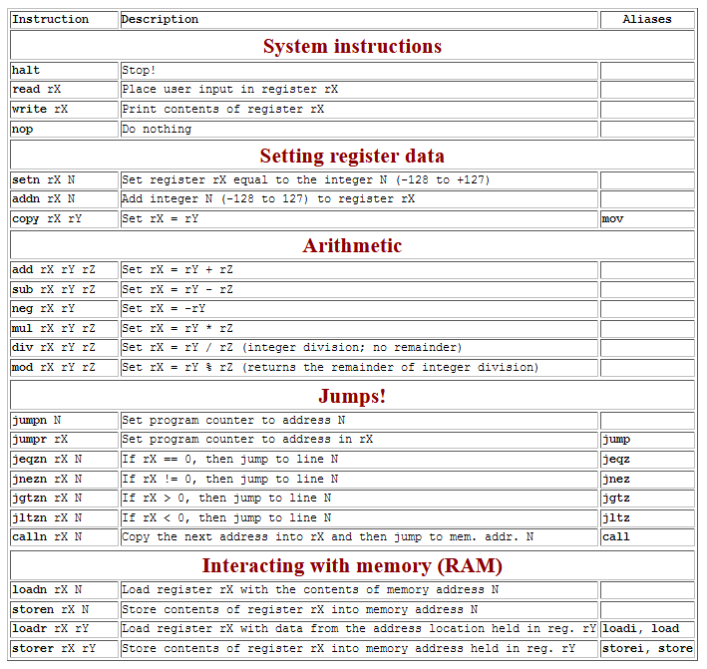
The Harvey Mudd Miniature Machine (HMMM)
Hmmm
the complete reference
At www.cs.hmc.edu/~cs5grad/cs5/hmmm/documentation/documentation.html

Slide 9
Example #1:
Screen
CPU
Von Neumann bottleneck
RAM
6
(input)
central processing unit registers
random access memory locations
6
read r1
0
r1
General-purpose register r1
1
mul r2 r1 r1
r2
add r2 r2 r1
2
General-purpose register r2
3
write r2
What does this program do?
halt
4

Slide 10
Example #1 (cont.):
Screen
6
6
(input)
read r1
0
# Get input from user to r1
# r2 = r1 * r1
# r2 = r2 + r1
# Print the contents of register r2 on standard output
# Halt program
1
mul r2 r1 r1
add r2 r2 r1
2
3
write r2
halt
4

Slide 11
Jumps in HMMM
jeqzn r1 42
IF r1 == 0 THEN jump to line number 42
jgtzn r1 42
IF r1 > 0 THEN jump to line number 42
jltzn r1 42
IF r1 < 0 THEN jump to line number 42
jnezn r1 42
IF r1 != 0 THEN jump to line number 42
Unconditional jump
jumpn 42
Jump to program line # 42
Indirect jump
jumpr r1
Jump to the line# stored in r1

Slide 12
Example #2:
Screen
RAM
-6
(input)
0
read r1
1
jgtzn r1 7
2
setn r2 -1
What function does this program implement?
3
mul r1 r1 r2
4
nop
Space for future expansion!
5
nop
6
nop
7
write r1
8
halt

Slide 13
Exercise
Write a Hmmm program to compute the following for x given as user input and output the result to the screen:
If x<0 3x – 4
else if x>0 X / 5
else X²+10 / 5

